Slide 1


Slide 2


Presentation Structure
Introduction
Questions to be answered by this project
Source & structure of data
Assumptions made
Steps to find solution
Challenges faced along the way
Things I’ve tried, didn’t work (& why)
Main Take-Home Message (conclusion)
Future development if more time
Limitation & problems with the solution
References
Q&A

Slide 3

Introduction
Who doesn't like to travel?
Especially for having fun and spending beautiful times exploring new destinations around the world!

Slide 4
Questions for the project
How long most tours are? What is the average tour price for that?
How does the tour duration affect the tour price?
Compare the tours average price of different countries.
Compare distribution of tour price for different cities.
How does the tour type affect the tour price?

Slide 5



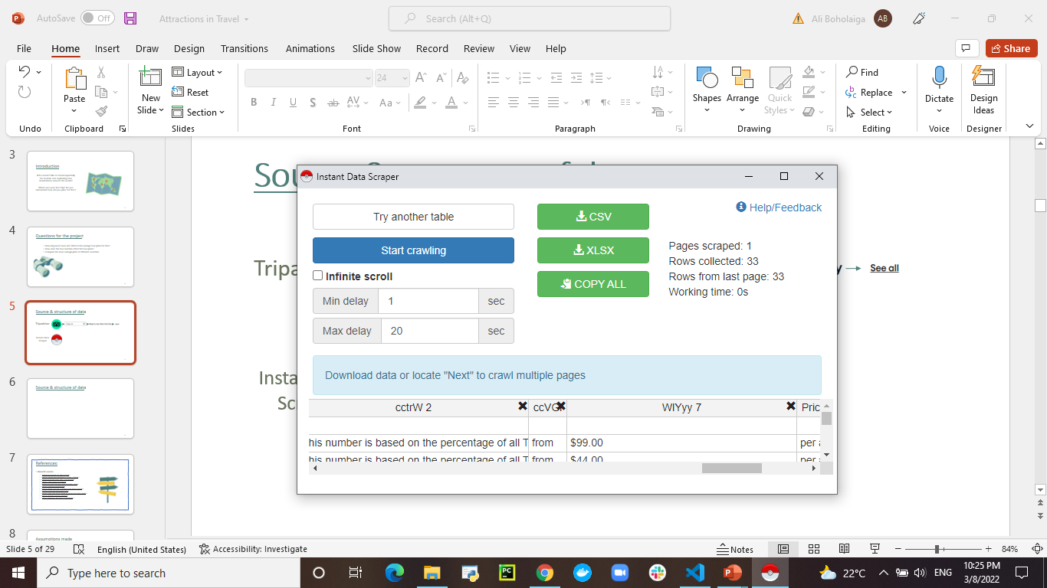

Source of data
Tripadvisor
Instant Data
Scraper

Slide 6
Structure of data
# | Column | Non-Null Count | Dtype
0 | Tour | 10889 non-null | object
1 | Type | 10889 non-null | object
2 | Duration | 10889 non-null | float32
3 | Price | 10889 non-null | float32
4 | Price Per | 10889 non-null | object
5 | Cancellation | 10889 non-null | object
6 | Tour By | 10889 non-null | object
7 | City | 10889 non-null | object
8 | Country | 10889 non-null | object
9 | Image | 10889 non-null | object
10 | Link to agency | 10889 non-null | object

Slide 7
Structure of data
df.sample()
 | Tour | Type | Duration | Price | Price Per | Cancellation | Tour By | City | Country | Image | Link to agency
10512 | Budapest Full Day Trip from Vienna | Bus Tours | 6.0 | 135.75 | per adult | Free cancellation | By Super Tours | Vienna | Austria | https://dynamic-media-cdn.tripadvisor.com/medi... | https://www.tripadvisor.com/Attraction_Review-...
Duration: in hours
Price: in $
Price Per: adult/group
City: 39 Cities
Country: 28 Countries
Link to agency: tours’ agency link insider tripadvisor.com

Slide 8

Assumptions made
The Bus Tours are the most popular tour type in this data
The popular average tour duration is 3-6 hours
The tour price per adult is more than price per group in the data but it doesn't mean it higher than per group in terms of money.
The tour price for the same tour type varies from one city to another.

Slide 9

Steps to find a solution

Slide 10
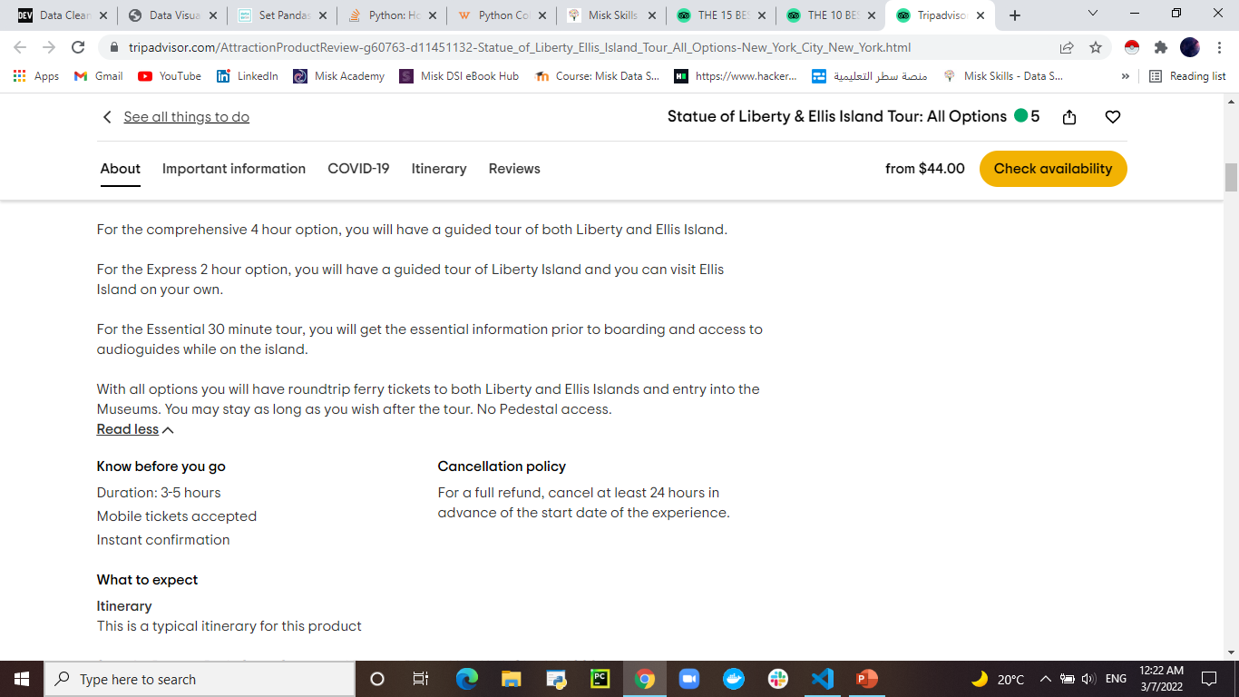





Tour Duration

Slide 11
Duration Column
Time Value
Duration Unit
Remove + and , from the values
Convert the value based on unit
Minimum time
Maximum time
Days * 24
Hours * 1
Convert them to float
Minutes / 60
Calculate the average

Slide 12

The median duration time of the tours is 4 hours long.
Most of the tours in this dataset are >= 4 hours long
The average tour price for the long tours is approximately $250. Whereas for all the short tours is less than $100.
How long most tours are?
What is the average tour price for that?

Slide 13
Find the median of the Duration column.
Split the Duration in the dataset into two lists: less than the median and greater than the median (4 hours long)
Split the average Price based on the long of duration
Bar plot to find the average price for each type of tour duration (short & long)

Slide 14
We can not determine a direct relationship between the tour duration and price.
The price varies even though the tours have the same duration time.
Other features can affect the price are: if the price was per adult or per group, the city or the country & the tour type.
How does the tour duration affect the tour price?

Slide 15
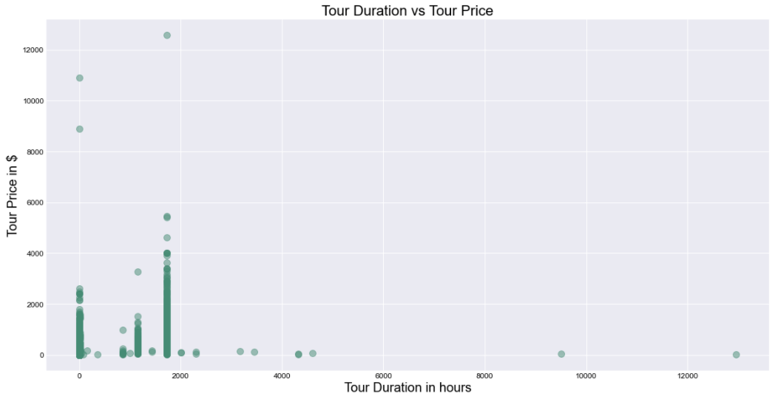

Slide 16
Between the countries, Oman has the highest average tour price, based on the summary statistics of the price per country we can see that the minimum tour price in Oman is $30. Whereas in the other countries (except Qatar) the minimum tour price is in this range ($3.35-$11.44)
So, regardless other features, Oman followed by Turkey then Saudi Arabia are the countries with the highest tours average price.
Compare the tours average price of different countries

Slide 19
Specify the city name
x = df[df['City'] == ‘City Name’]
x['Price'].hist()
I’ll Compare between 3 cities in China
Beijing,
Shanghai &
Hong Kong
Compare distribution of tour price for different cities

Slide 20
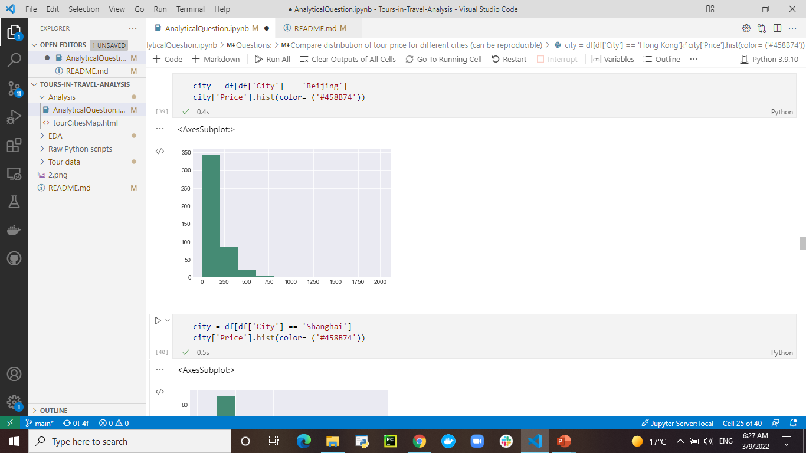
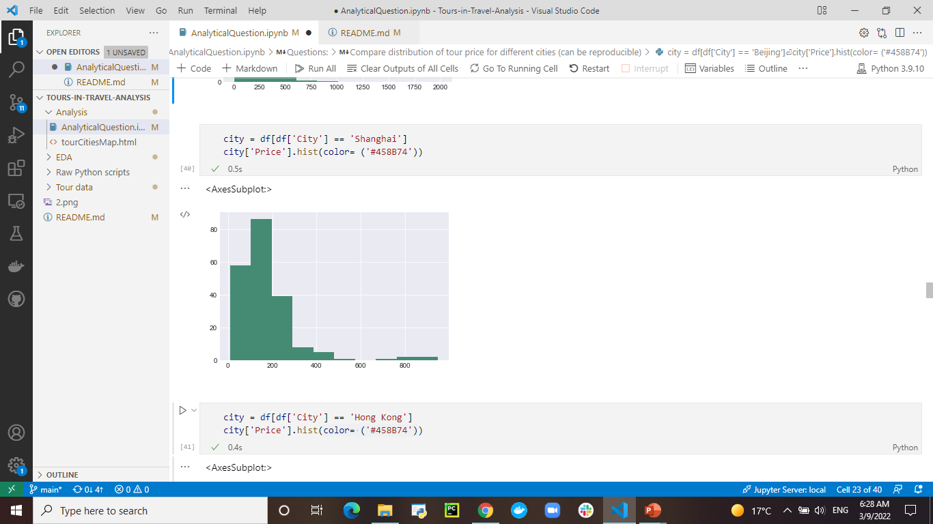
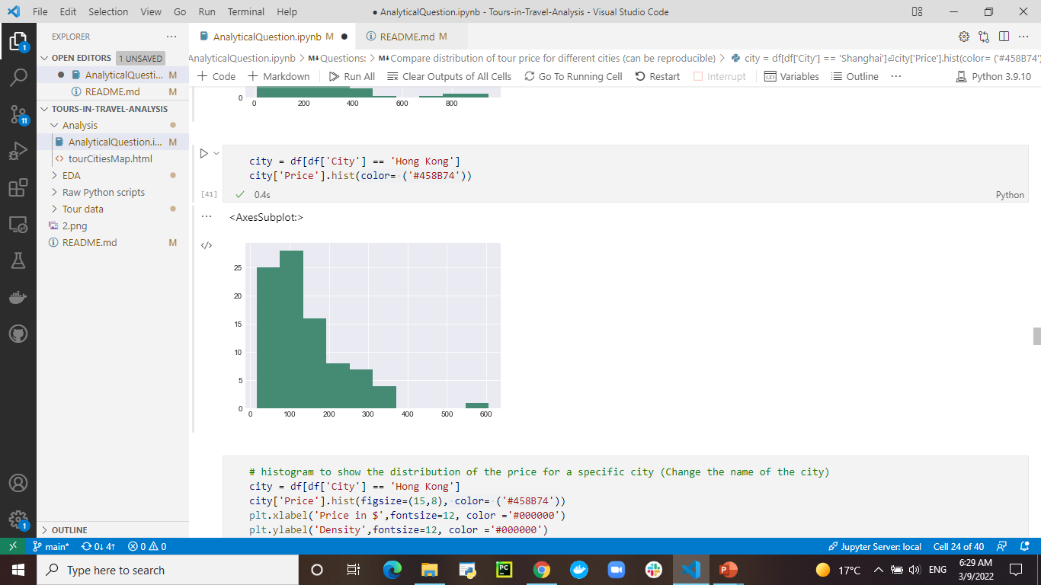
Beijing
Shanghai
Hong Kong

Slide 21
The tours different types affect the tour price. But most of the types have an average tour price less than $200
I have a problem with the plot. I can’t read the data
How does the tour type affect the tour price?

Slide 22
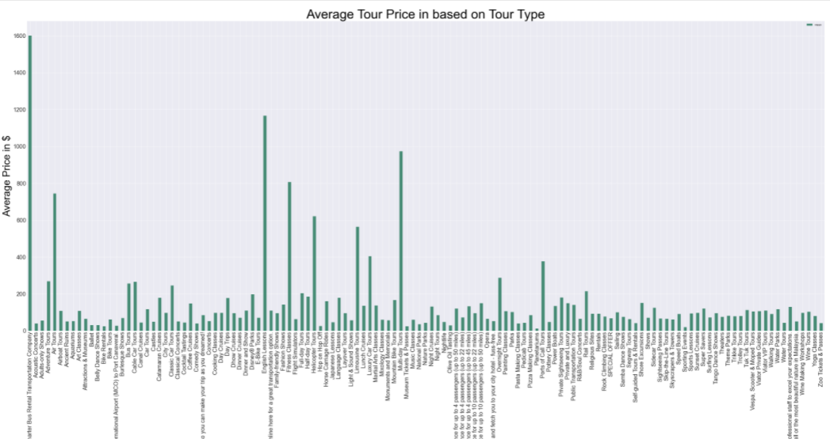

Slide 23

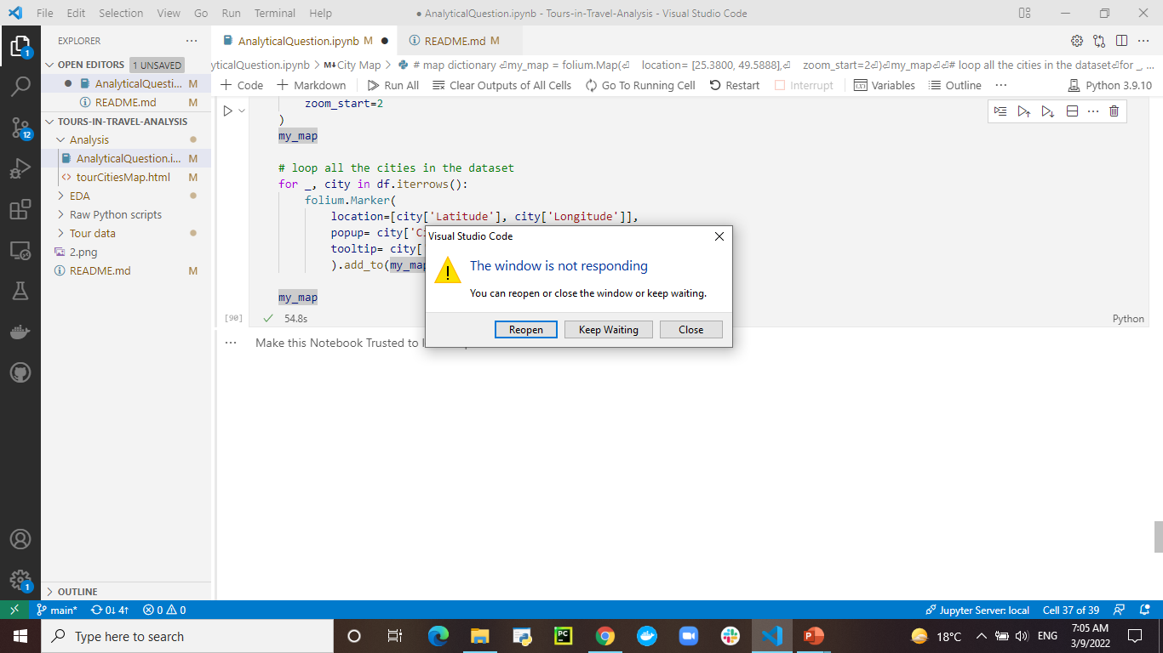
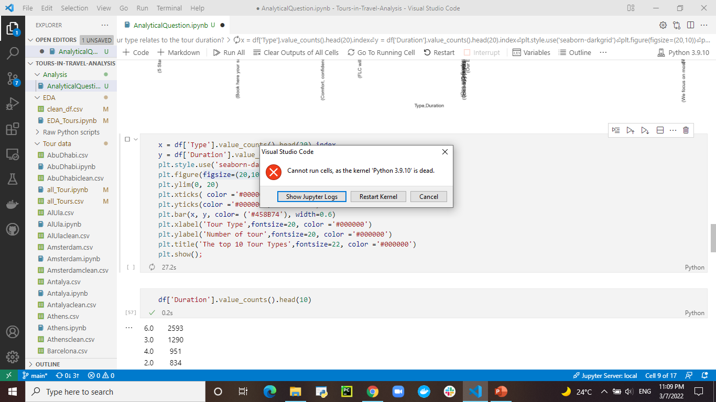
The challenges I faced along the way
Most of the time my laptop not responding or my VS Code having installation issues or the kernel dead.
Other Challenges, thinking of questions & finding the right code for implementation.

Slide 24
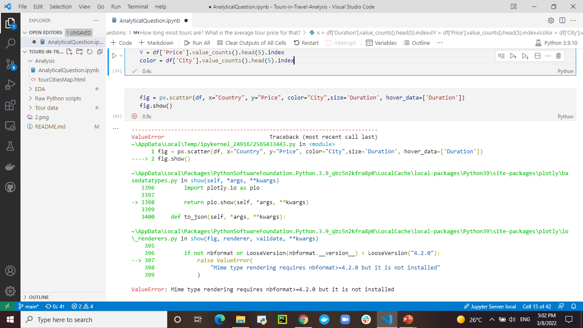
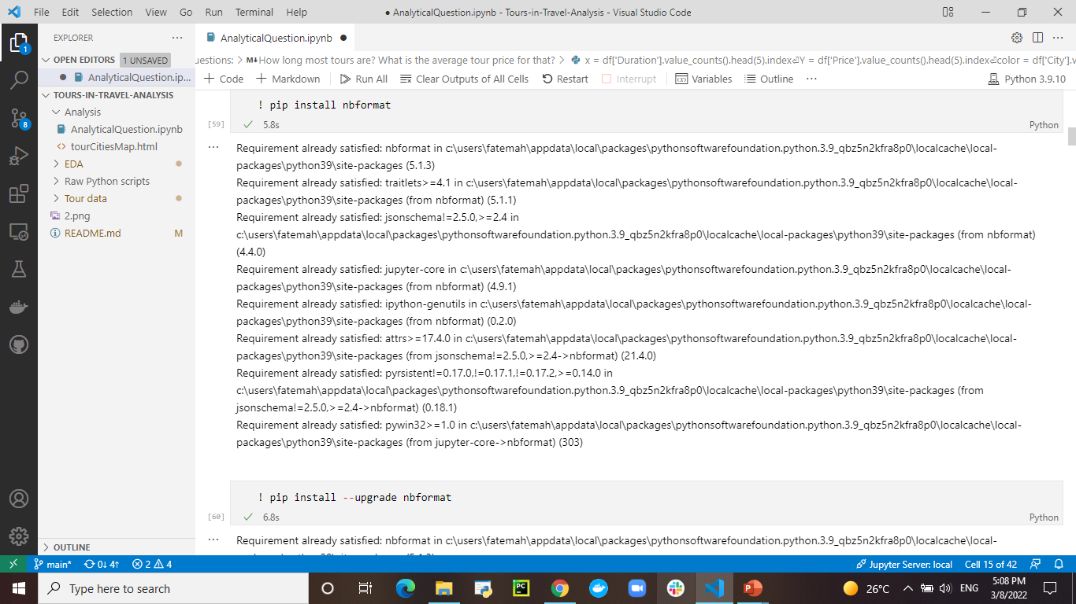
Things I've been tried & didn't work
I’ve tried scatter plot with Plotly, but it didn’t work.

Slide 25
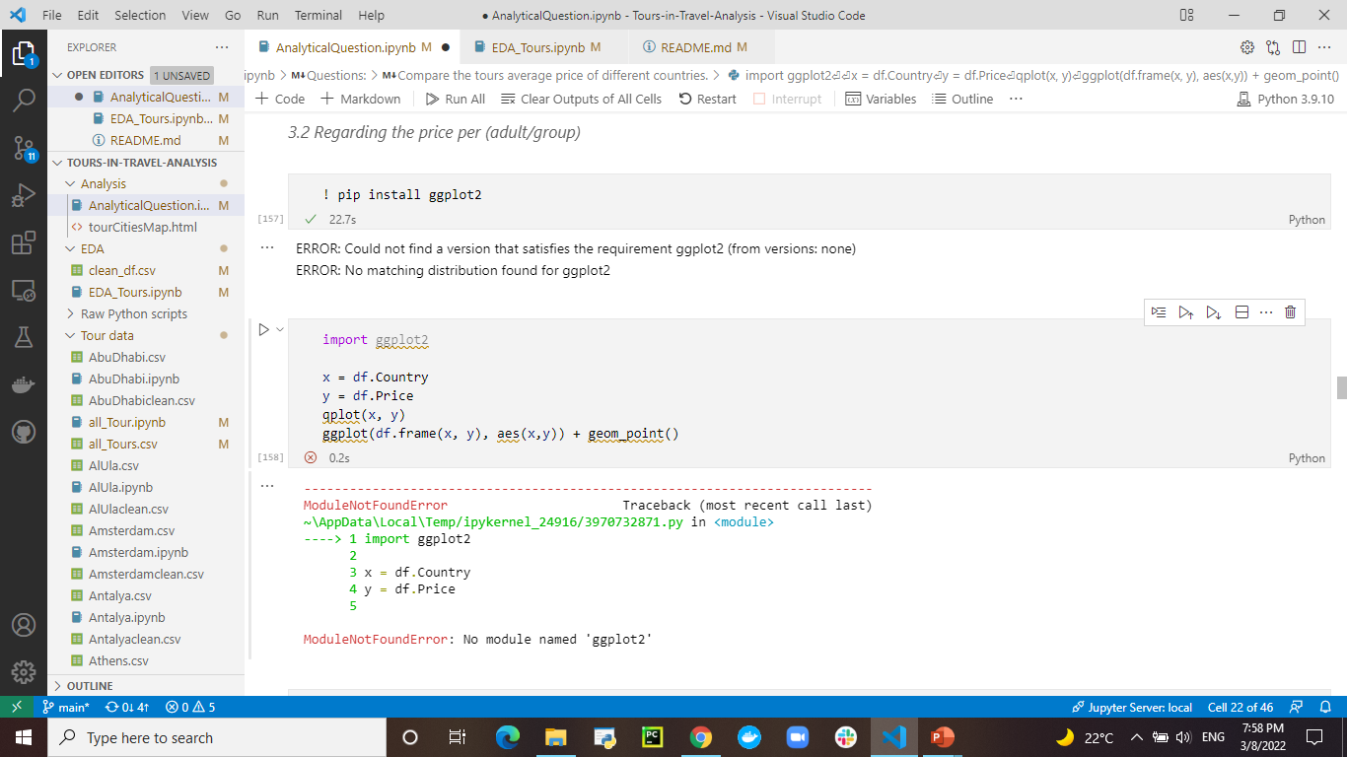
Things I've been tried & didn't work
I’ve tried importing ggplot2, but I got error message about the version I used couldn’t satisfy the requirement of ggplot2.

Slide 26


Take-Home Message (conclusion)
Knowing that most of the tour duration is taking 4 hours or longer, put in your mind how many days you are going to have in your next trip if you want to explore more places and attractions.
The price will vary based on the tour type, duration & the trip destination. Consider to travel as a group since most of tours price per group is less than tour price per adult.

Slide 27


Future development of your project
Collecting more data
splitting the data based on the unit of tours and having 3 datasets
Tours in Days
Tours in Hours
Tours in Minutes (Short tours)
Make sure collecting more numerical data such as Rate, number of travelers …
Write a blog with my analysis.
Build a recommender system for tours.

Slide 28

Limitations & problems with my solution
Limitations
No column for Rate, since TripAdvisor shows the rate as a circles not a number.
I have two numerical features only.
The cancellation feature doesn’t make impact since all the tours are flexible & doesn’t charge for cancellation.
Problems
with plotting, in which I have extreme values that makes reading the plot hard.

Slide 29

References:
Research sources:
Reading and Writing CSV Files in Python
How to combine two dataframe in Python – Pandas?
Pandas recalculate index after a concatenation
Pandas – Split Column by Delimiter
Replace nan with the same value of another column
Pandas conditional multiplication
How to Change Font Size in Seaborn Plots (With Examples)
Creating Interactive Maps with Python
pandas create new column based on values from other columns
How to calculate summary statistics?
Python Histograms, Box Plots, & Distributions

Slide 30

Q&A
Special Thanks
Dr. Rick Scavetta
Lujain Felemban
Sarah Alharbi
My colleagues

Slide 31
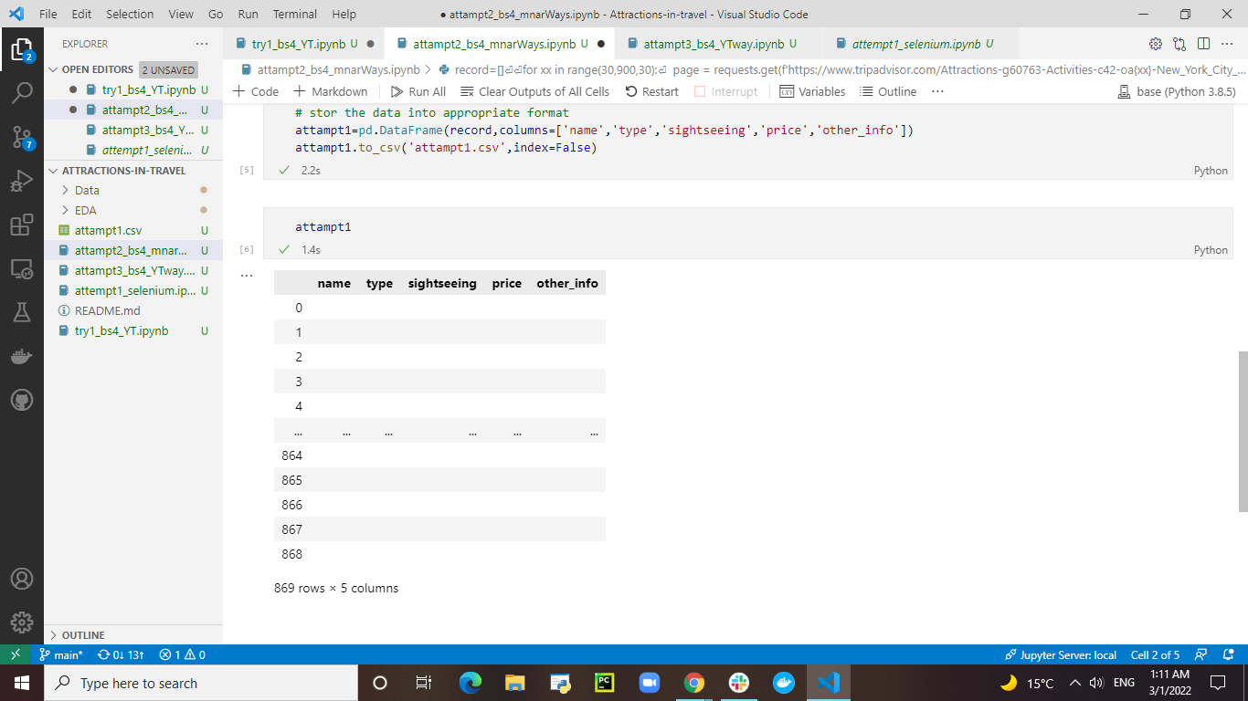
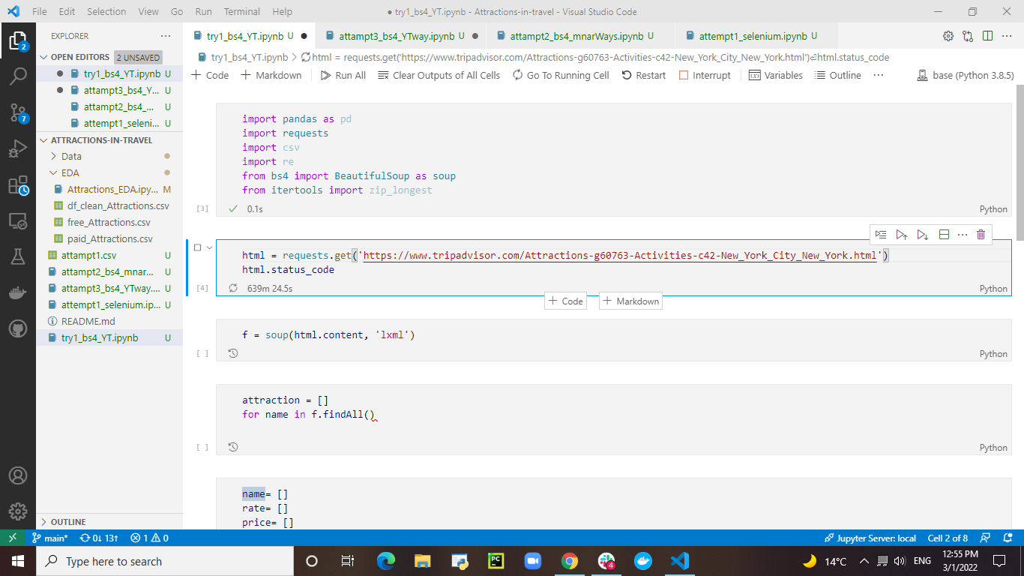
Challenges I faced in working on initial idea
Not scraping data
with BeautifulSoup

Slide 32
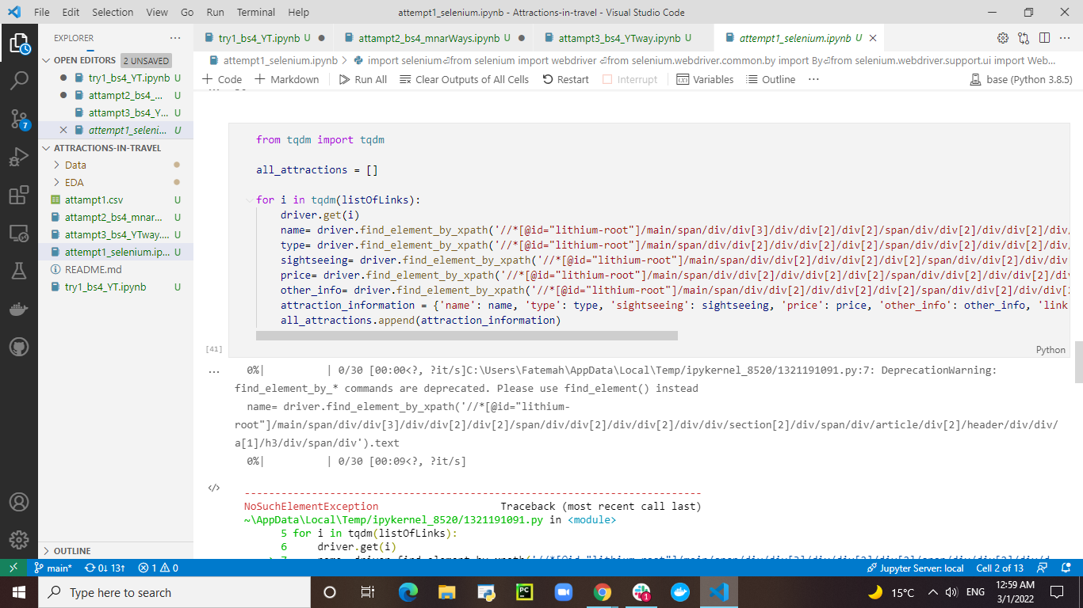
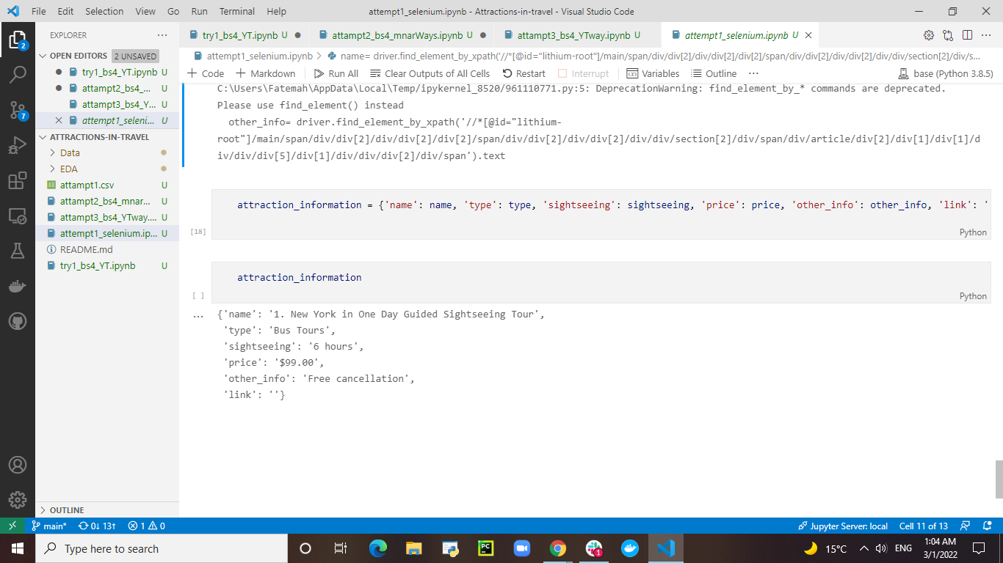
Inside the loop
Outside the loop

Slide 33
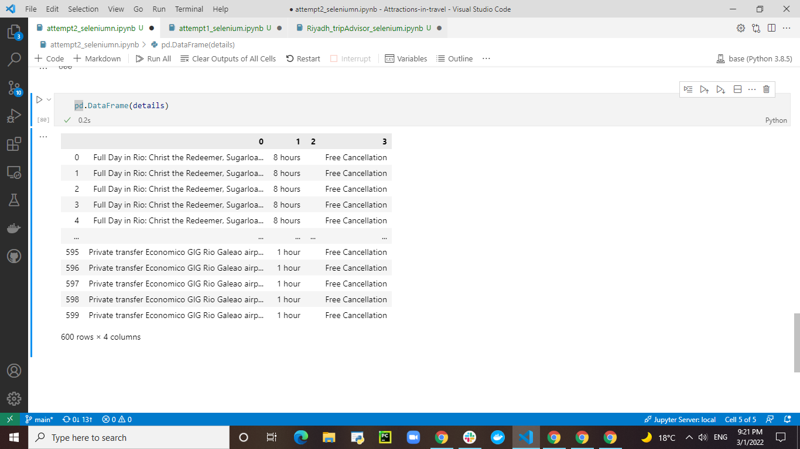
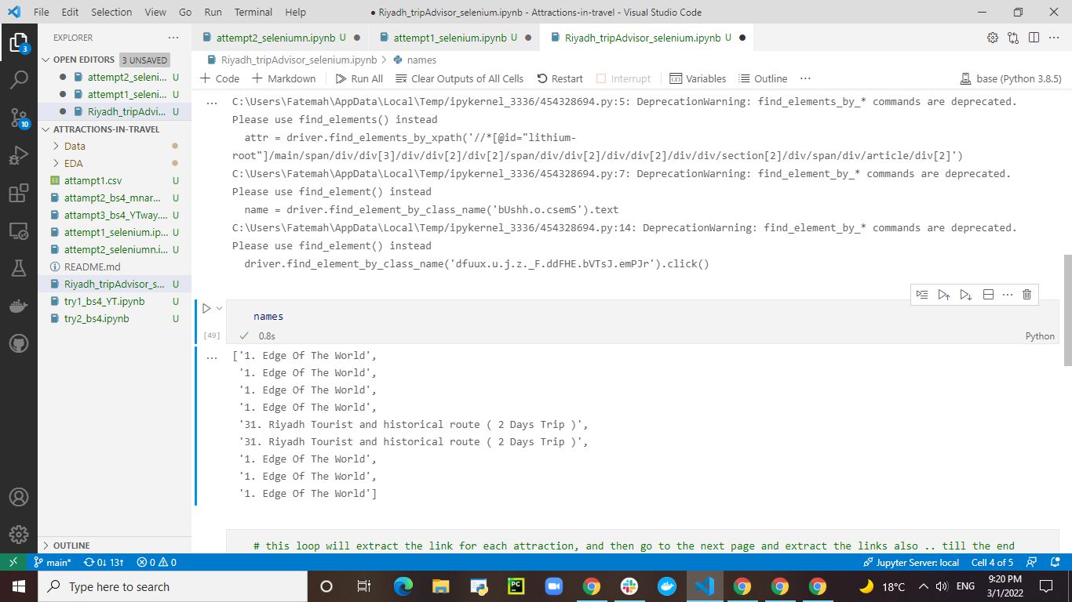
Repeating the same value

